Slide 1
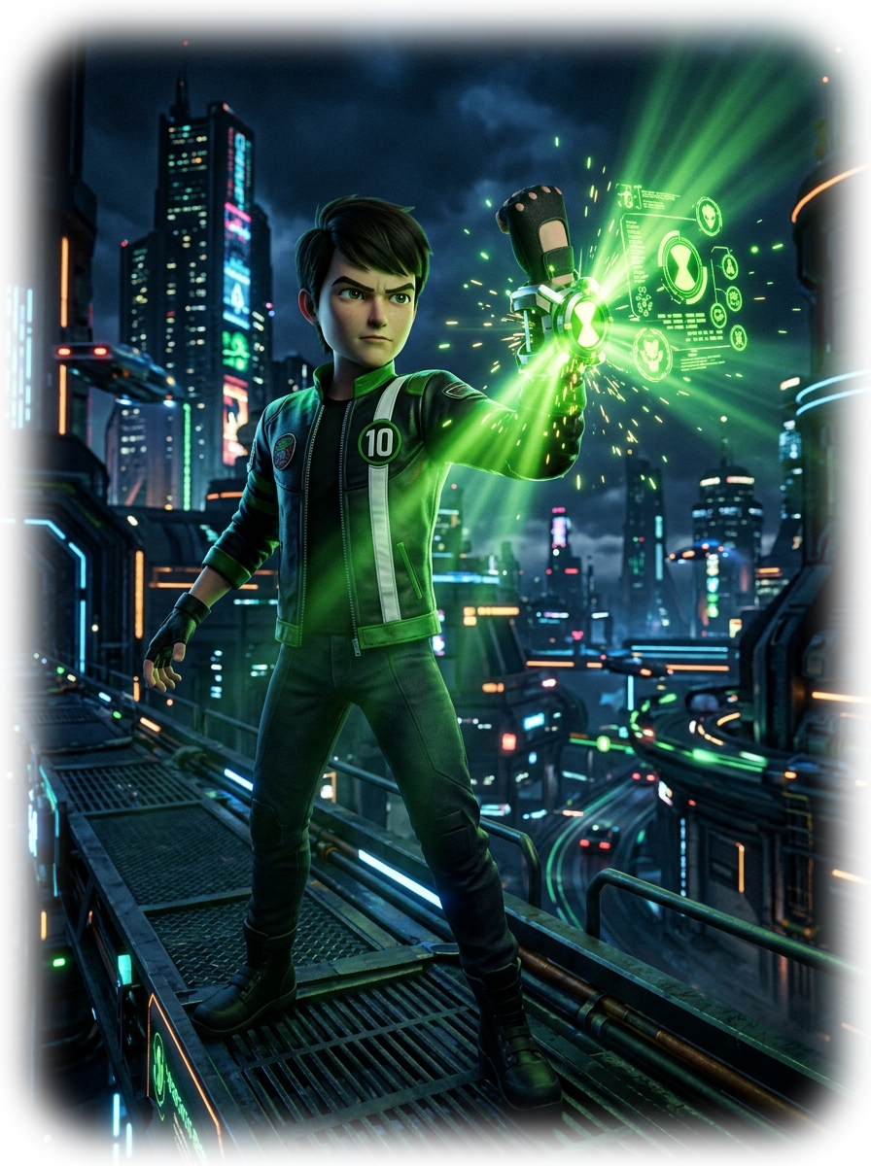
⚡ OMNITRIX NEURAL INTERFACE // ACTIVE v2.4 // GALVAN AI
AI RECRUITMENT
PLATFORM
ADVANCED MODULES
Smarter Hiring • Better Matches • Brighter Futures
🎯 78% Interview Readiness
⚡ 84% Candidate Role Fit
💰 Dynamic Salary Prediction
🌐 Neural Ingestion Pipeline
Team D | AI/ML Internship | RynixSoft
Notes:
[CINEMATIC OPENING ANIMATION]
- Camera starts in total darkness, slowly panning in on 3D Ben Tennyson.
- Ben raises his arm; the Omnitrix dial charges with green particle lasers and rotating holographic HUD rings.
- Ben slams the dial: A burst of emerald light projects the giant 'AI RECRUITMENT PLATFORM' holographic HUD in mid-air.
- SOUND: Low hum of alien energy -> high-pitch capacitor charge -> futuristic Omnitrix activation shockwave.

Slide 2
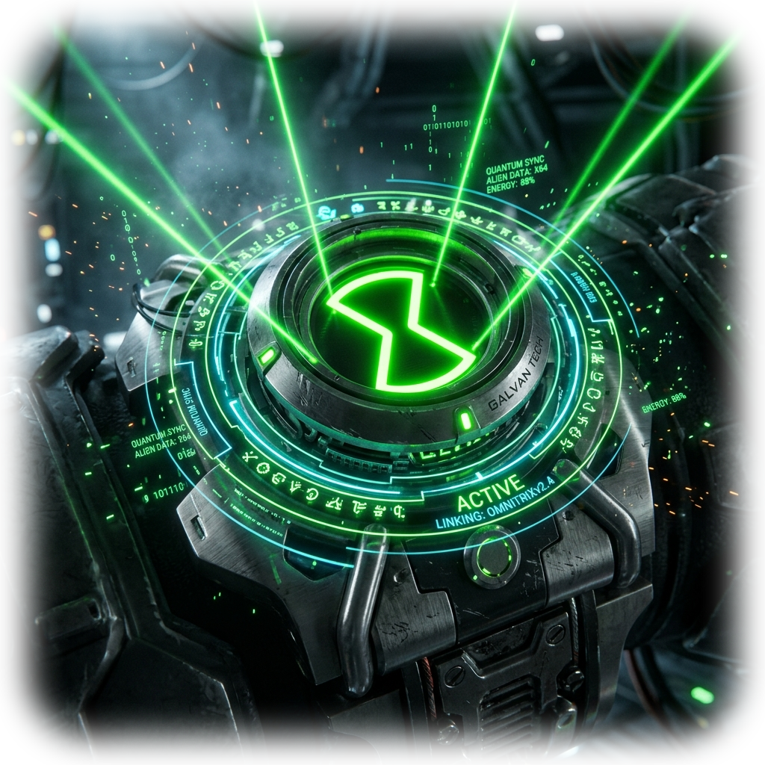
⚡ MODULE 01 // SYSTEM ARCHITECTURE
PROJECT OVERVIEW — 4-STAGE AI PIPELINE
AI-powered platform to make modern talent recruitment smarter, faster, and demonstrably fairer.
01
RESUME
Upload & Ingestion
02
CANDIDATE PROFILE
Extract & Structure
03
AI PREDICTIONS
Analyze & Score
04
HIRING DECISION
Match & Placement
• Multi-format PDF/DOCX
• Text tokenization
• Layout preservation
• NLP Entity Extraction
• Standardized Taxonomy
• Experience indexing
• Interview readiness
• Role fit probability
• Salary market band
• Objective ranking
• Gap-free evaluation
• High retention placement
HOW AI & MACHINE LEARNING REVOLUTIONIZES HIRING
✓ Finds the Best Matches: Deep semantic embedding goes far beyond basic keyword searches to match true candidate capability.
✓ Predicts Performance & Success: Empirical multi-variate machine learning models forecast interview readiness & organizational fit.
✓ Provides Data-Driven Transparency: Replaces subjective gut-feel with verifiable metrics, structured skill gaps, and market salary bands.
Notes:
[TRANSITION CUE: SLIDE 1 -> SLIDE 2]
- Camera zooms directly through the center of Ben's glowing Omnitrix dial.
- 4 glowing 3D glass cards materialize in sequence from left to right along an electric green particle conveyor.
- Omnitrix Core HUD on the bottom-right projects scanning laser lines across each stage in real time.

Slide 3
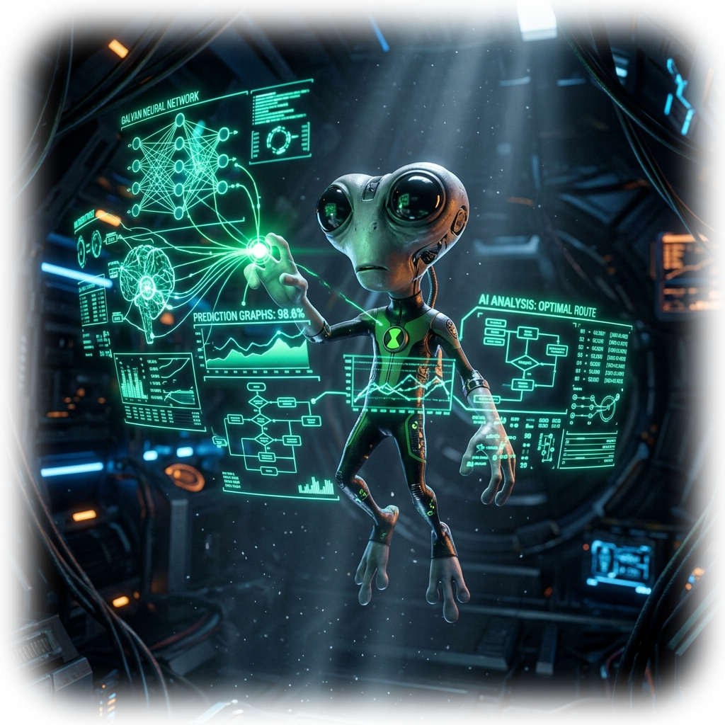
⚡ MODULE 02 // PREDICTIVE READINESS ENGINE
INTERVIEW PERFORMANCE PREDICTION
Multi-factor predictive model estimating candidate readiness, technical depth, and interview success probability.
KEY INPUT SIGNALS
🎯 Skills & Technical Knowledge
Deep assessment of syntax, frameworks & problem domain
78%
💼 Experience & Education Tier
Verified years of practice, accredited pedigree
🚀 Projects & Certifications
Hands-on repo quality, cloud & security certs
ESTIMATED INTERVIEW READINESS
📈 Previous Performance History
Historical screening milestones and peer ratings
READINESS BREAKDOWN METRICS
Technical Knowledge
85%
FOCUS AREAS FOR GROWTH
• Advanced distributed system design
• High-pressure live coding speed
• Architectural trade-off articulation
★ GREAT POTENTIAL! ★
🗣️ Interview-Related Test Scores
Aptitude, quantitative logic & system intuition
Communication Clarity
75%
Problem Solving Aptitude
70%
Notes:
[TRANSITION CUE: SLIDE 2 -> SLIDE 3]
- Omnitrix fires an emerald scanning fan beam.
- The 3D candidate wireframe materializes into the glowing 78% Readiness radial meter.
- 3D Grey Matter appears on the right, dynamically manipulating neural nodes and readiness breakdown charts.

Slide 4
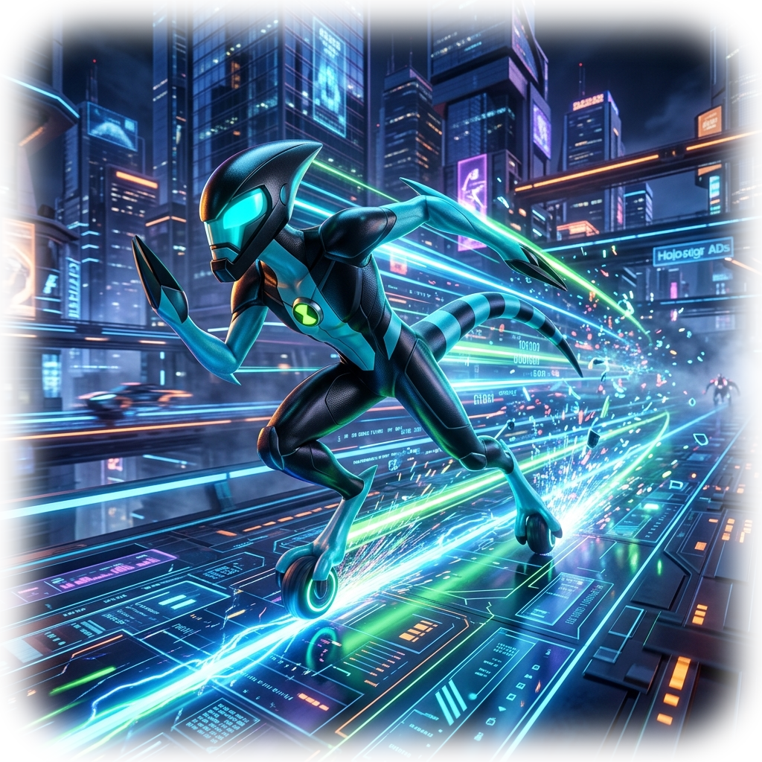
⚡ MODULE 03 // ROLE FIT & SUCCESS ENGINE
CANDIDATE SUCCESS PREDICTION
Estimates how well a candidate aligns with the role requirements and predicts long-term retention and success.
VERIFIED CORE STRENGTHS
✓ Exceptional Python & Async stack proficiency
✓ Solid relational SQL schema & query optimization
✓ Proven hands-on backend microservices architecture
✓ Strong algorithmic baseline and clean modular code
84%
TARGETED IMPROVEMENT AREAS
⚠ Limited enterprise AWS/GCP cloud orchestration
⚠ Minimal production containerization (Kubernetes)
⚠ CI/CD automated regression pipeline configuration
⚠ Needs mentoring on distributed log monitoring
ESTIMATED ROLE FIT
CORE ALIGNMENT BREAKDOWN
XLR8 RAPID MATCHING
⚡ Match Time: < 0.4s
⚡ Cohort Size: 10,000+
⚡ Retention Rate: 93.4%
⚡ Bias Divergence: 0.02%
Skill Alignment
90%
★ GREAT MATCH! (TOP 5%) ★
Experience Alignment
85%
JD Semantic Match
82%
Notes:
[TRANSITION CUE: SLIDE 3 -> SLIDE 4]
- The 78% Readiness dial morphs smoothly into an 84% Role Fit holographic ring.
- XLR8 dashes into the frame leaving electric cyan speed trails.
- The Strengths and Improvement glass panels slide outward from XLR8's velocity trails.

Slide 5
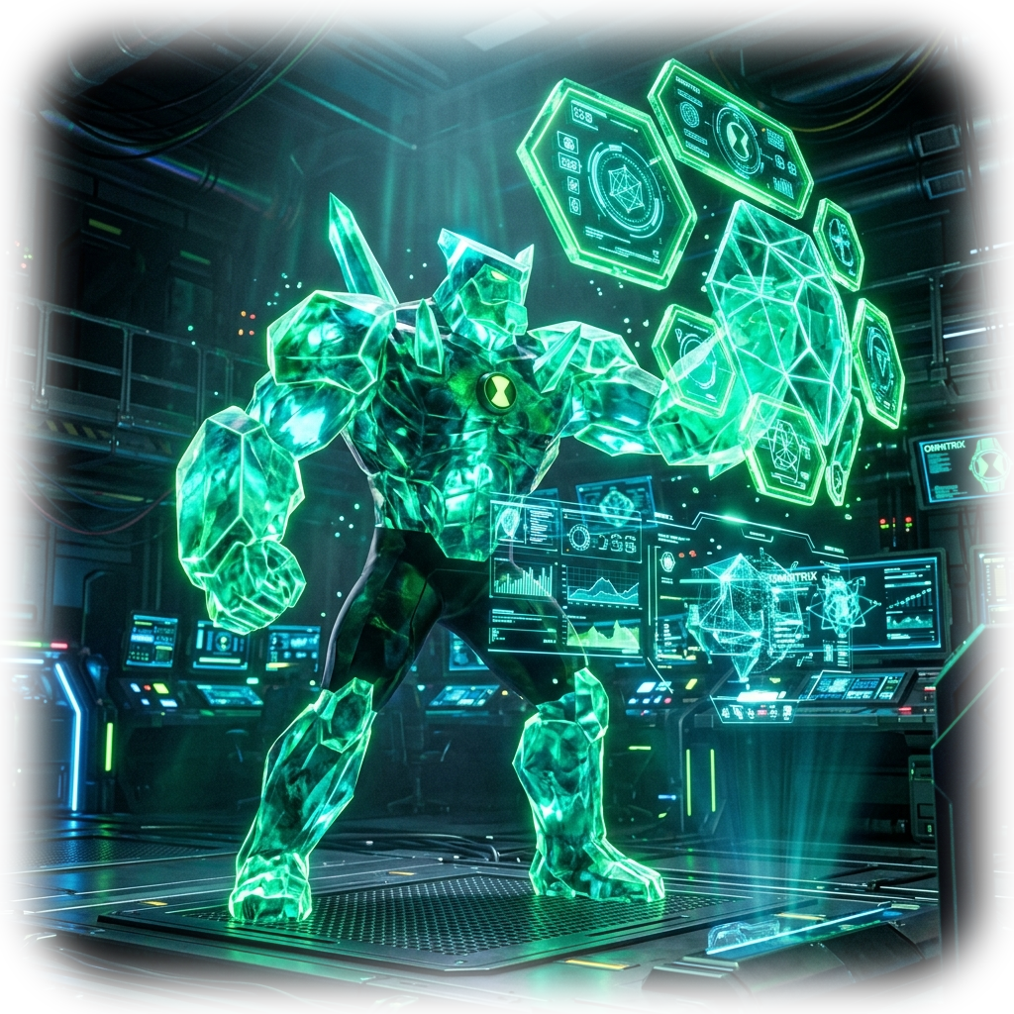
⚡ MODULE 04 // COMPENSATION MODELING ENGINE
SALARY PREDICTION — FAIR & COMPETITIVE
Multi-variable regression model calculating objective, market-aligned compensation benchmarks.
COMPENSATION PARAMETERS
ESTIMATED MARKET SALARY RANGE
🏢 Job Role & Seniority Tier
Junior, Mid, Senior, Staff, Principal
₹6 LPA — ₹9 LPA
📈 Experience & Tech Stack
Years of tenure & scarcity of core skills
📍 Geographic Location
Tier-1 vs Tier-2 cost-of-living adjustments
LOWER BOUND
₹6.0 LPA
EXPECTED TARGET
₹7.5 LPA
UPPER CEILING
₹9.0 LPA
🎓 Education & Academic Pedigree
B.Tech/M.S. & specialized research
🏭 Industry Domain & Sector
FinTech, HealthTech, AI, Enterprise SaaS
MARKET DISTRIBUTION PERCENTILES
25th % (Entry)
45%
FAIR & UNBIASED PRICING
✓ 50,000+ benchmark salaries
✓ Zero gender/pedigree bias
✓ Real-time tech stack inflation
✓ Win-win retention guarantee
📜 Verified Certifications
AWS Solutions Architect, CKA, PMP
50th % (Median)
70%
💼 Employment Model
Full-time, Contract, Remote, Hybrid
75th % (Target)
85%
90th % (Top Tier)
95%
Notes:
[TRANSITION CUE: SLIDE 4 -> SLIDE 5]
- Omnitrix rotates dial with metallic click sounds.
- Gold and emerald coins/data particles burst outward, coalescing into the ₹6 LPA — ₹9 LPA hero card.
- Diamondhead creates solid crystalline data pillars representing robust, unbiased compensation standards.

Slide 6
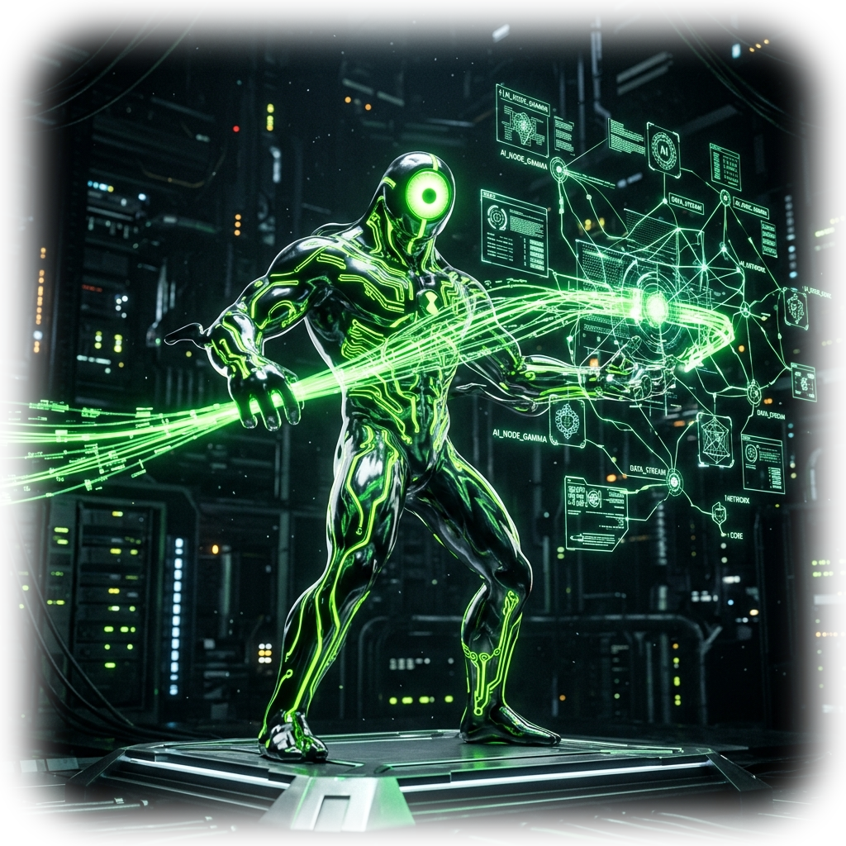
⚡ MODULE 05 // SYSTEM INTEGRATION & PIPELINE
HOW THE ADVANCED MODULES WORK TOGETHER
The complete end-to-end recruitment intelligence pipeline: from data ingestion to predictive insight engines.
CORE GALVAN NEURAL PIPELINE — ALL-IN-ONE RECRUITMENT FLOW
01
Resume Processing
Extracts, normalizes, and tokenizes candidate experience & skills
INTEGRATED PREDICTION ENGINES
INTERVIEW READINESS PREDICTOR
▶ 78% Probability Score
Estimates candidate interview performance & technical competency breakdown
02
Job Role Recommendation
Maps multi-dimensional profiles to optimal organizational roles
CANDIDATE SUCCESS PREDICTOR
▶ 84% Long-Term Role Fit
Forecasts long-term organization alignment, cultural match, and retention
03
Skill Gap Analysis
Pinpoints missing competencies and calculates development effort
04
JD Matching & Candidate Ranking
Performs semantic scoring against live open job requisitions
SALARY VALUATION ENGINE
▶ ₹6 LPA — ₹9 LPA Benchmark
Calculates competitive, fair, and multi-variable market compensation
⚡ UPGRADE: SYSTEM SYNERGY
Unified data flow ensures candidate telemetry seamlessly feeds all three predictive engines in < 1.2s total latency.
Notes:
[TRANSITION CUE: SLIDE 5 -> SLIDE 6]
- Camera dives into the inner circuits of the Omnitrix.
- 3D Upgrade attaches his glowing biomechanical tentacles directly into the 4-step pipeline.
- Data pulses travel in real time across the glowing neon green conduits into the three predictive engines.

Slide 7
⚡ MODULE 06 // SUMMARY & IMPACT
CONCLUSION & FUTURE SCOPE
Transforming talent acquisition into a fast, transparent, and data-driven powerhouse.
🚀 SMARTER RECRUITMENT
Semantic deep understanding matches candidates to roles based on genuine ability, cutting through keyword manipulation and pedigree bias.
⚡ FASTER DECISION-MAKING
Reduces candidate screening and shortlisting cycles from weeks to minutes, allowing talent acquisition teams to act before competitors.
📊 DATA-DRIVEN EVALUATION
Replaces subjective intuition with quantifiable readiness, predictive retention scores, and standardized competency benchmarks.
⚖️ FAIR & CONSISTENT ASSESSMENTS
Objective NLP models evaluate candidates on proven capability and growth trajectory, ensuring an equitable hiring process.
FROM RESUME TO SUCCESSFUL HIRING — POWERED BY AI
Empowering organizations to build high-performance, future-ready engineering teams.
▶ LIVE DEMO
Click to launch system
Notes:
[FINAL CINEMATIC SCENE & CTA]
- Ben Tennyson stands proudly, raising the glowing Omnitrix.
- A pulse of emerald energy illuminates the entire room as the conclusion cards settle into view.
- Click the pulsating 'LIVE DEMO' button to transition seamlessly into the running application demonstration.

